Slide 1
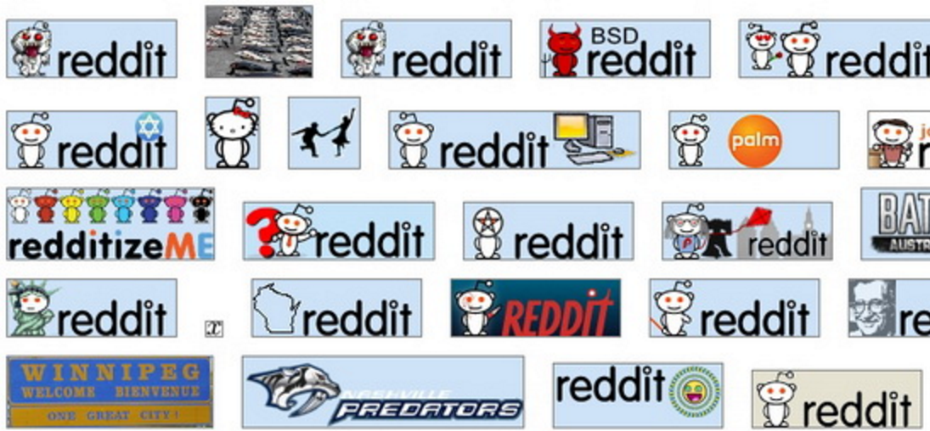
Subreddit Recommendation Engine
Thomas Voreyer

Slide 2
The Project
Reddit has a wealth of information, and I decided it would be smart idea to use it
I looked at the possible data and thought about identifying how users differ in preference and personality
From there, I determined that user personality could be inferred from subreddit personality
So, I made it my primary objective to infer a subreddit personality

Slide 3
The Data
Started the project with the Top 100 posts of the past year for the Top 100 Subreddits
Expanded this number to the top 250 Subreddits
(25,000 Posts)
Information Gathered:
Post Name
Post Link Type (.com, .html, .png, .gif, …)
All associated comments
Post score

Slide 4
Inferring Personality
I generated word lists corresponding to personality traits and ideologies
I would go through the comments of each subreddit to determine which word lists were most present
I would infer personality based upon the relative occurrences of these word lists
I would also infer personality from what format the post was (com, gif, html, …)

Slide 5
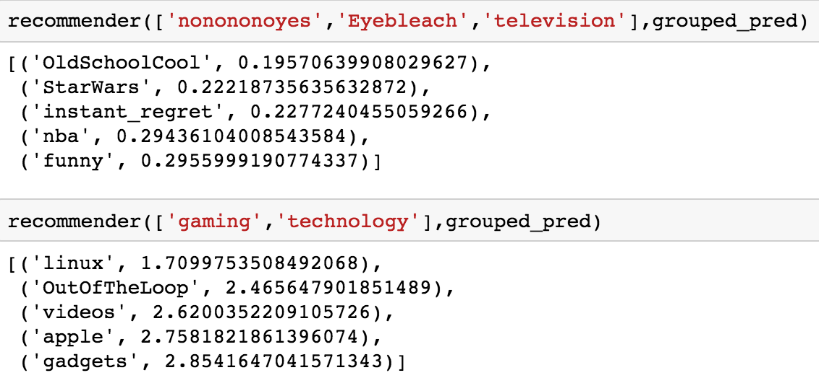
My Creation
Based upon what subreddits a user likes, I can tell them what subreddits are a good match for them

Slide 6
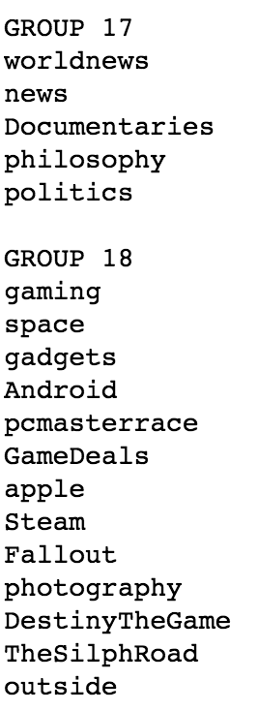
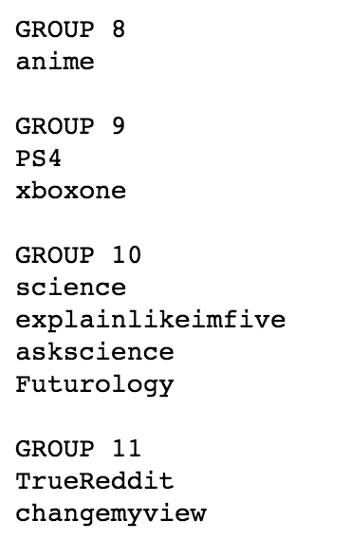
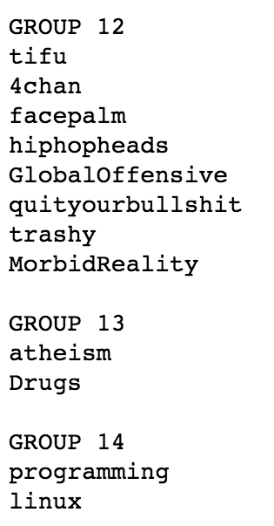
Some of the Predicted Groups
I can also create groupings of similar subreddits to ‘map out’ the different categories

Slide 7

Let’s Do Some Predictions

Slide 8
Conclusion
We now have a working recommendation engine, all thanks to data science
It is important to remember though that data science isn’t just putting random things into a blender and getting out something amazing
Data science is
Focused on understanding the data
In order create the appropriate model
So we can create meaningful results

Slide 9
Questions?

